Slide 1
Passive Workout Assistant
DGMD E-14 Final Project
Blake Graham, Ping Ji, Yusheng Jiang and Austin High

Slide 2
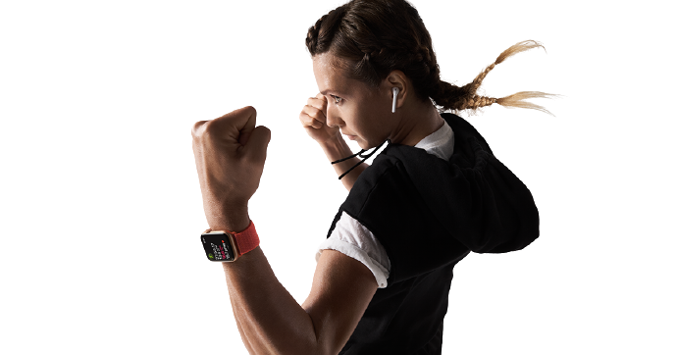
Project Summary and Description
Market is filled with activity trackers but most require manual intervention to track activity types, reps, and sets
Proposed Solution
Create a Passive Workout Assistant to track a person’s workout

Slide 3
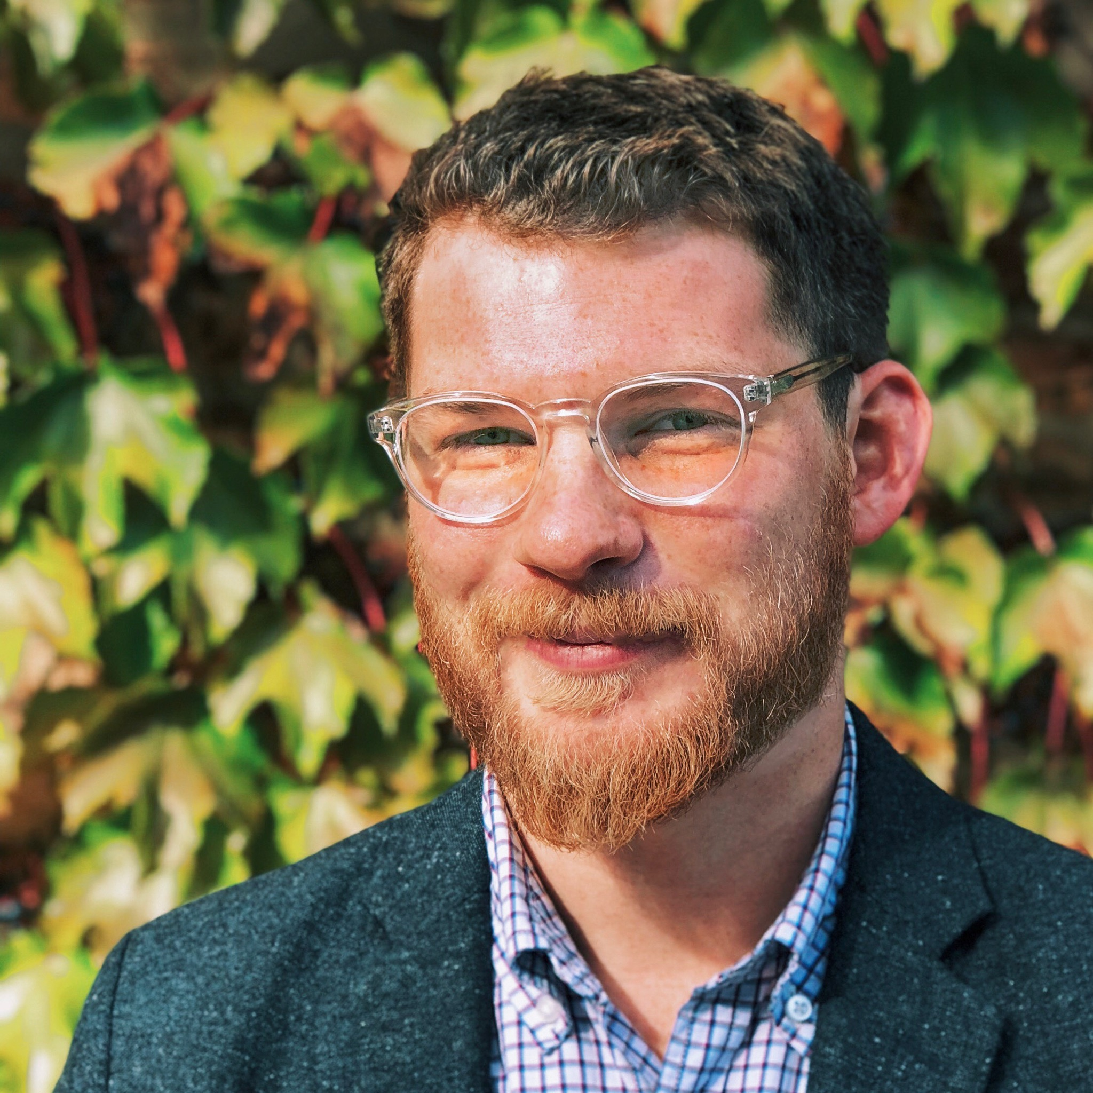



Your Project Team & Agenda
Project introduction and scope
Data collection and Demo
Data prep and analysis
Summary and future opportunities
Questions and Answers
Blake Graham
Program Manager
Ping Ji
Graphic Designer
Yusheng Jiang, PhD
Data Scientist II
Senior Data Analyst
Austin High
Software Engineer

Slide 4
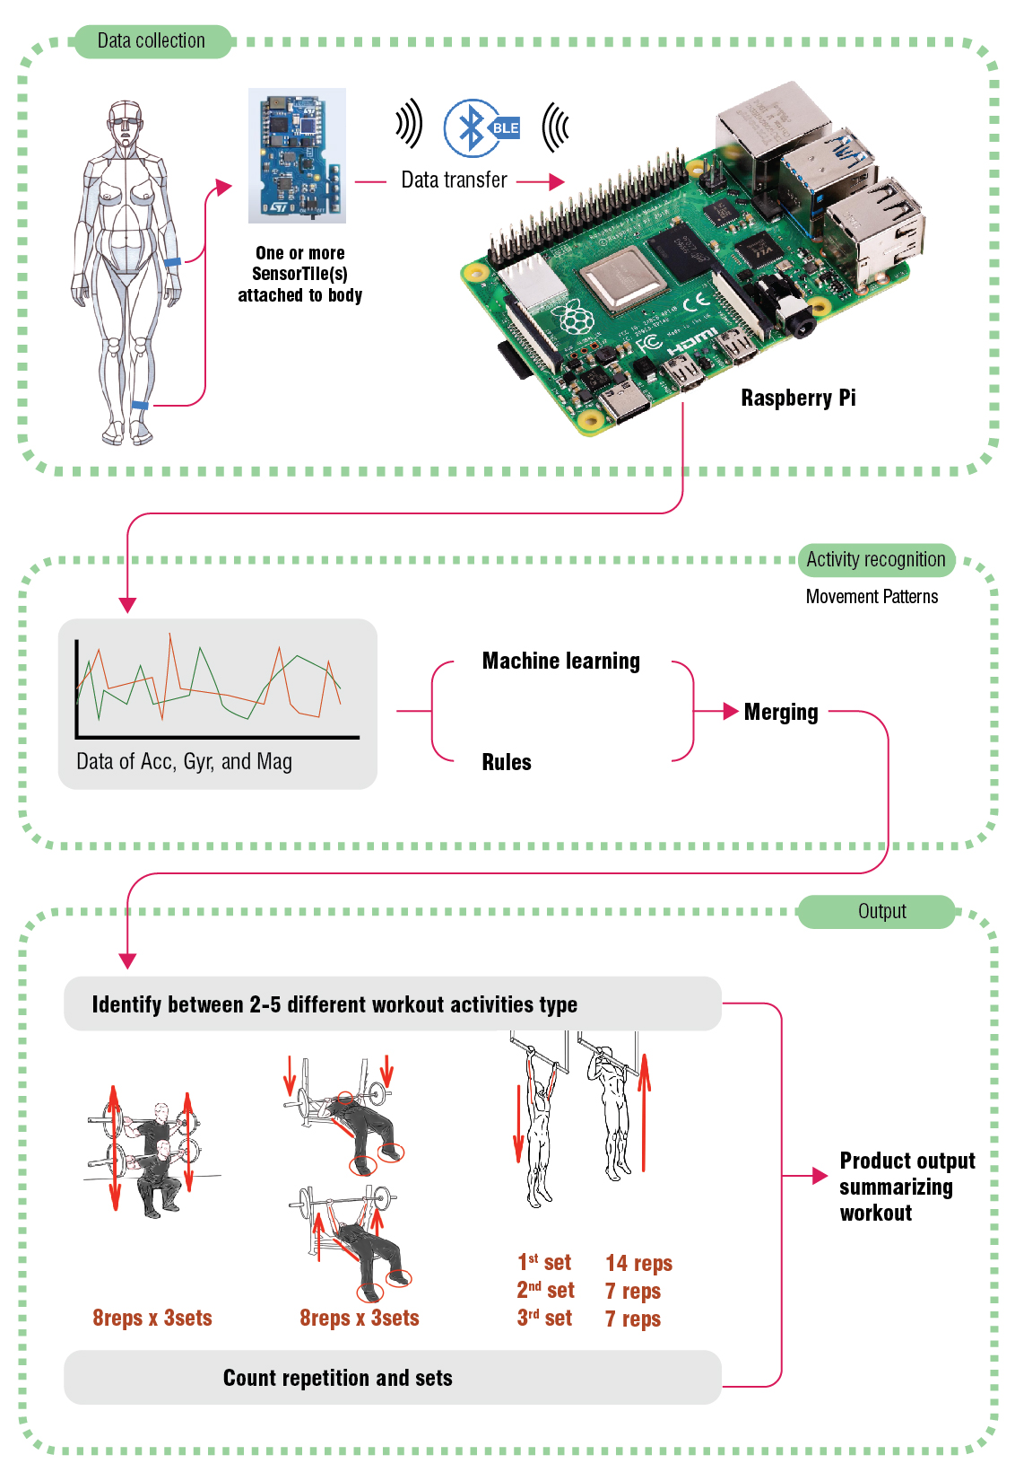
Meet the Passive Workout Assistant
Inspired by other projects that track athletic activity data capabilities and technology was defined
Core Functionality
Devices Required
Identify between 2-5 different workout activities type
Count repetition and sets
Output workout summary
Sensortile
Sensortile cradle
Raspberry Pi
Power for Sensortile

Slide 5
Scope
With unlimited resources, the Workout Assistant would handle voice commands, the ability to track athlete’s performance in many different exercises, and wifi connectivity to store workout results in a cloud based app.
Our MVP (Minimum Value Product) will focus on delivering the data processing / ML components of the application.
Notes:
In an effort to develop this product iteratively, our team will release a product that is useful in the short term, and foundational towards these larger goals.

Slide 6







Methodology And Software
Collect Data
Import to Python Jupyter Notebook
Split Train & Test data (0.8:0.2)
Model Training with Multiple Classifiers
Test data for Accuracy and Performance
Evaluate influence of Vars comparing coefficients
Select most performant model
Collect SensorTile data from individuals completing workout activities
Import CSV or text files into a python-based Jupyter notebook, data exploration, including visualization and statistical moments calculation
Split data into training data and testing data by a ratio of 0.8 : 0.2
Training data will be modeled by multiple classifiers
Testing data will be used to check the accuracy of the model, and evaluate the performance of the model to the whole dataset
The influence of a variable would be evaluated by comparing related coefficients
The model with the best performance will be selected to predict the workout activity

Slide 7
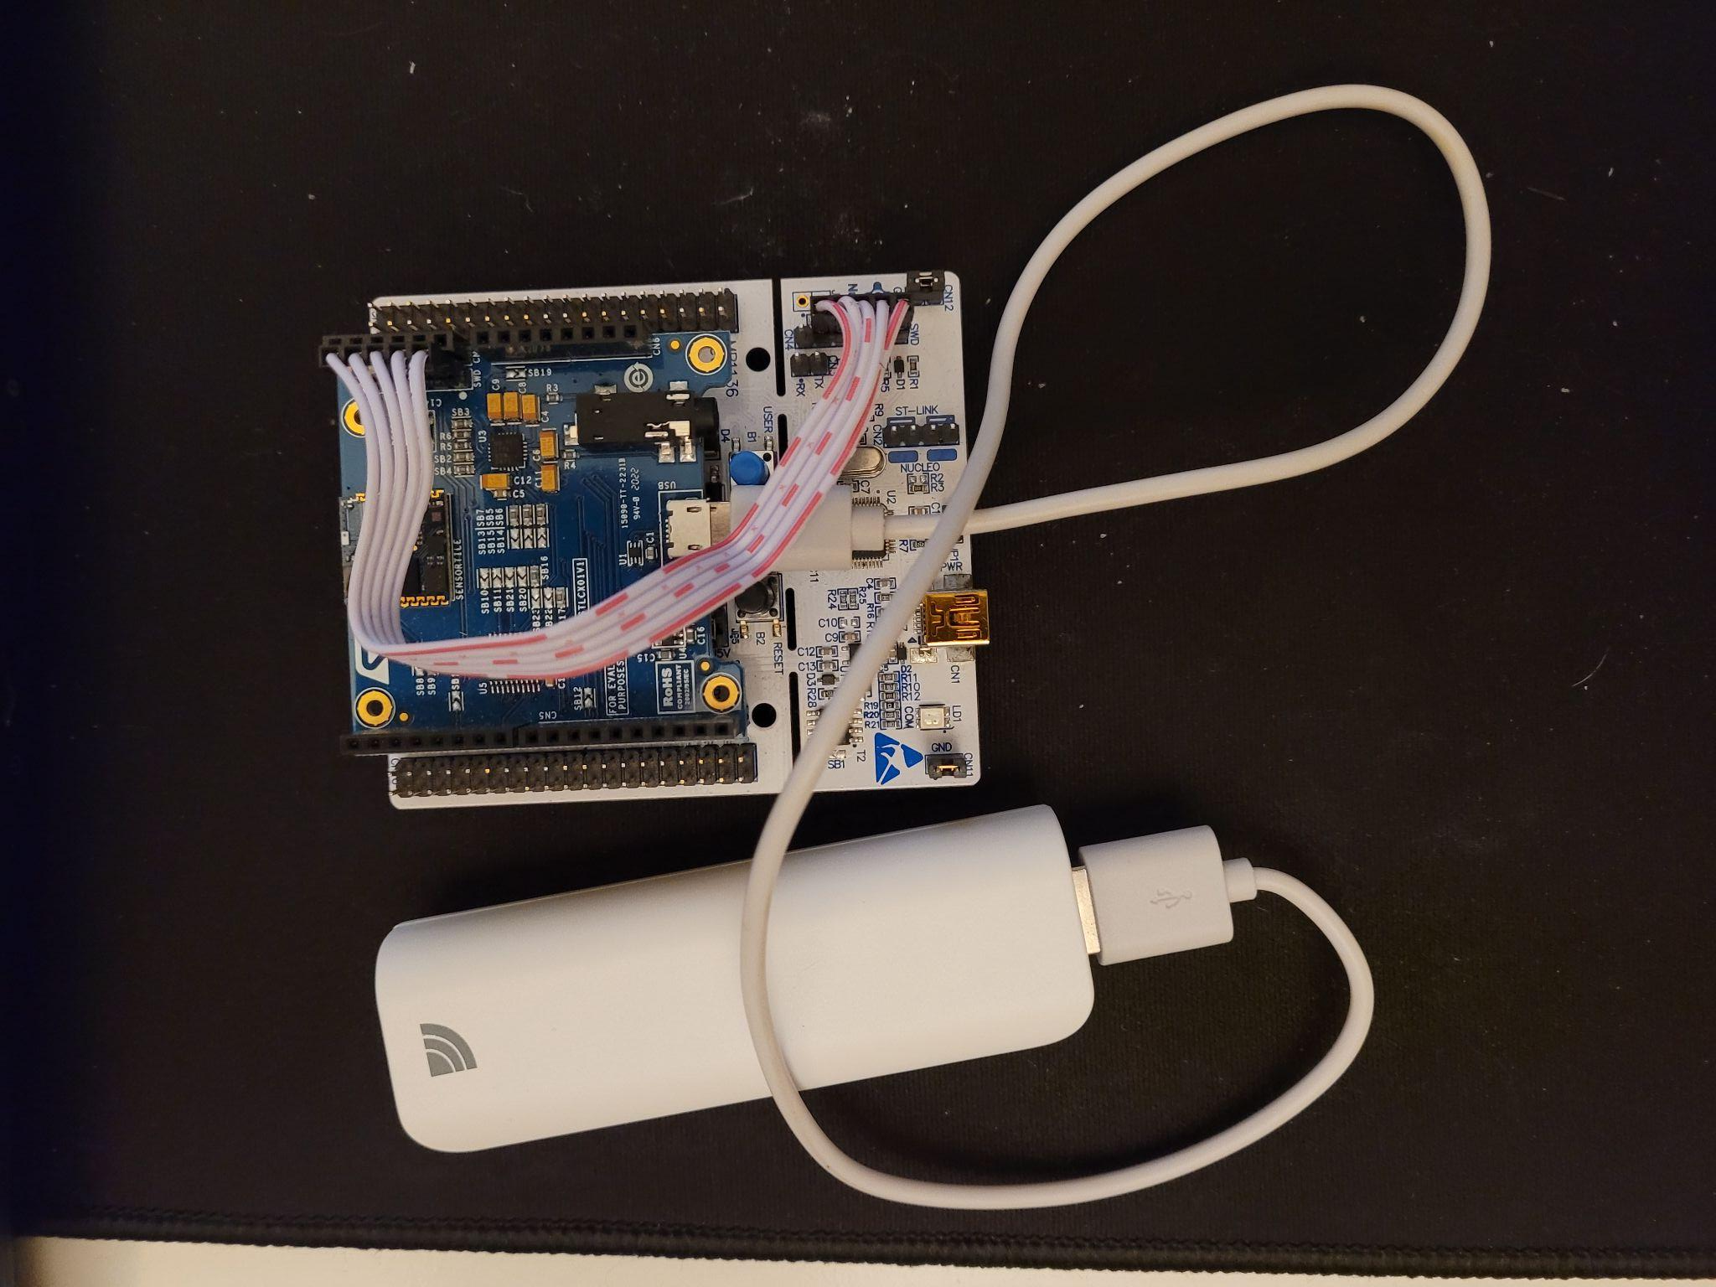
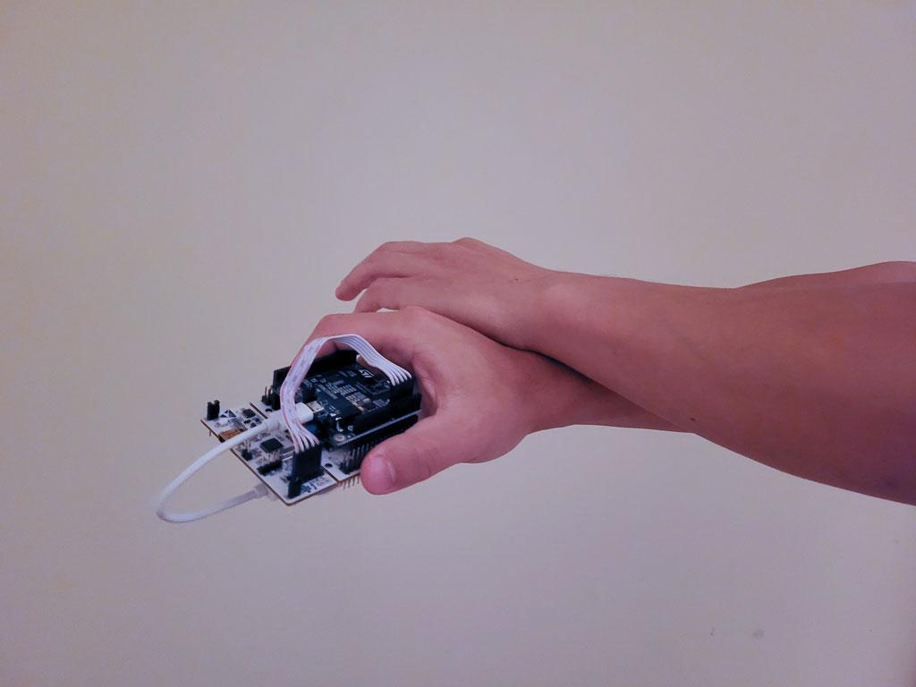
How We Collected Data
Data was collected by the SensorTile
The SensorTile is holding in hand while workout
Data is transmitted through BLE from SensorTile to Raspberry Pi
20 sets x 30 reps of proper form’s data are recorded.
20 sets x 30 reps of improper form’s data are recorded as well for comparison/training purposes.

Slide 8

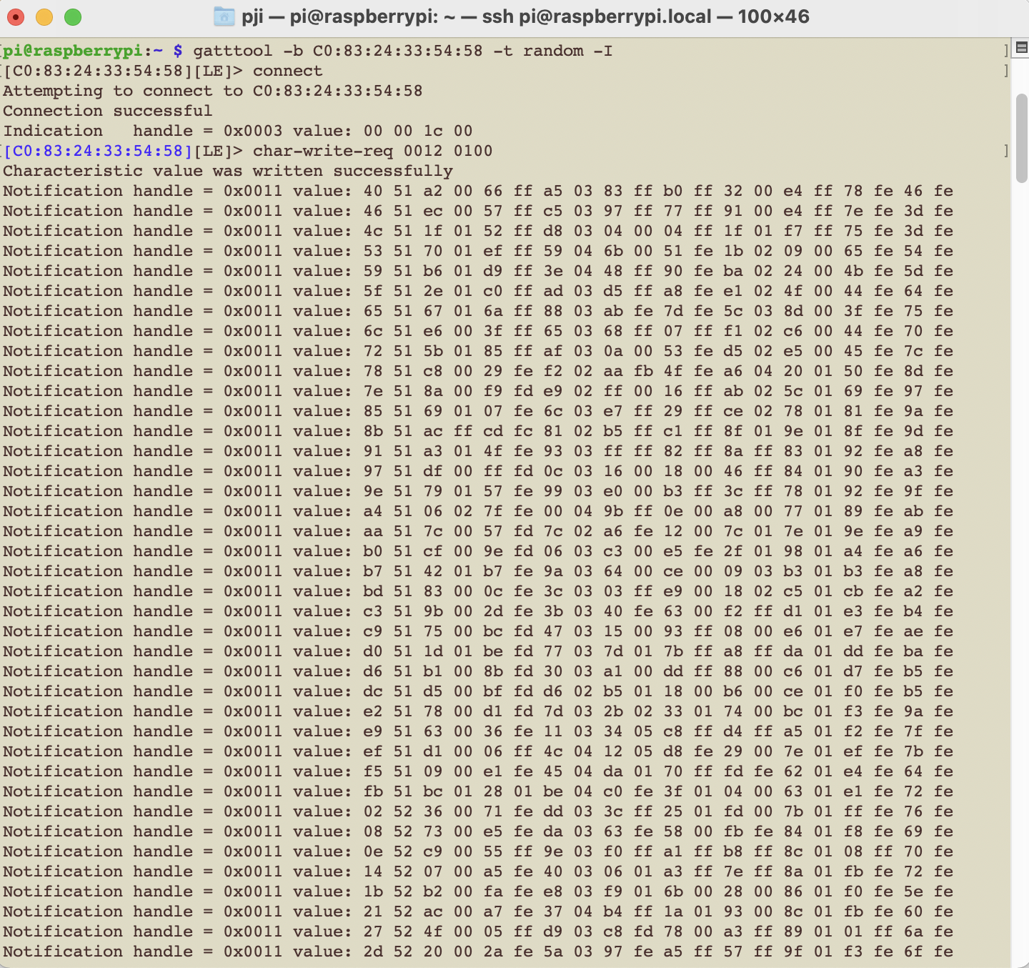
Demo

Slide 9
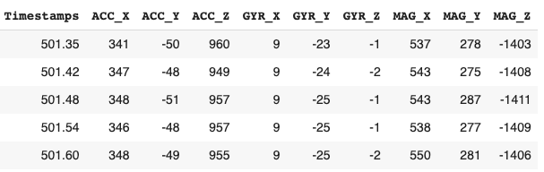
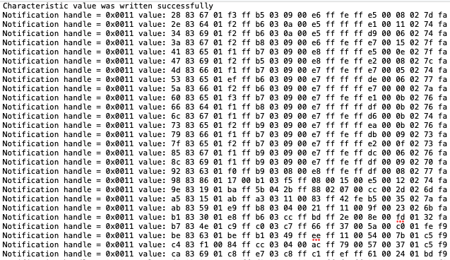
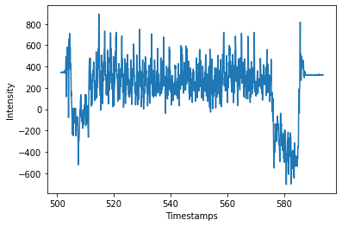
Data Preparation and Cleaning
Data were collected in two formats: CSV files and text files with hexadecimal values
Hexadecimal values were processed into decimal format using python code
Both ends of the data were truncated
Data in decimal format
ACC_X
Raw Data

Slide 10
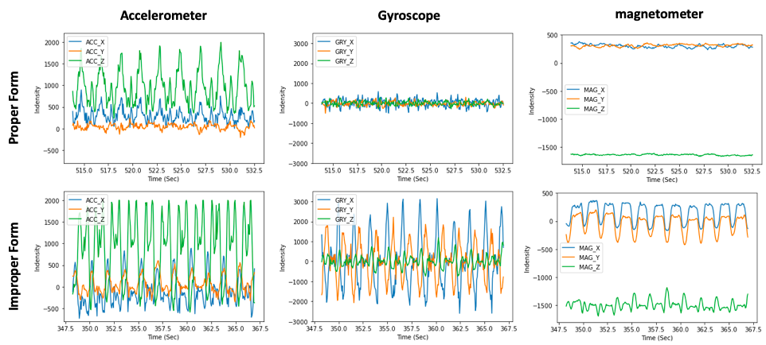
Data visualization

Slide 11
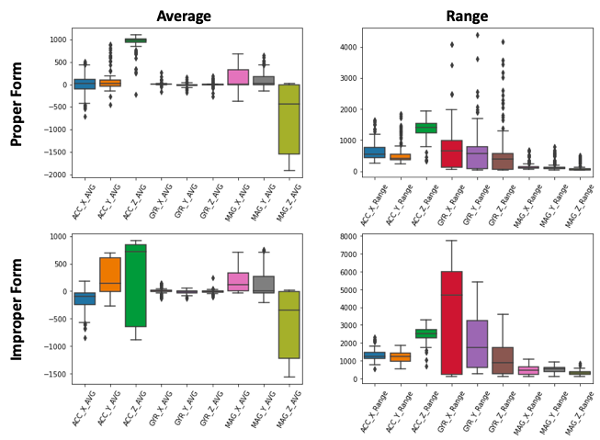
Representing data using average and range
Variables | P-values
ACC_X | 8.06e-37
ACC_Y | 0.077
ACC_Z | 0.027
GYR_X | 0.925
GYR_Y | 0.771
GYR_Z | 0.820
MAG_X | 3.66e-31
MAG_Y | 9.65e-95
MAG_Z | 3.88e-78

Slide 12
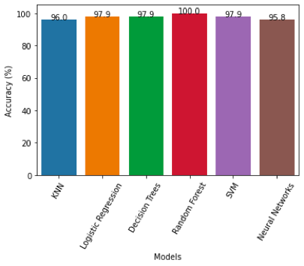
Machine Learning Models Used & Accuracies
KNN
Logistic regression
Decision trees
Random Forest
Support Vector Machine
Neural Networks

Slide 13
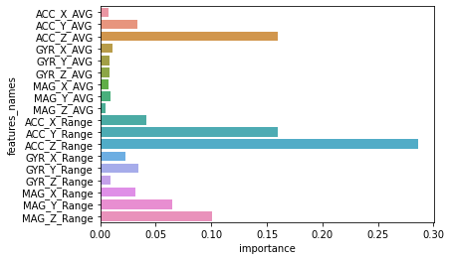
The influence of the variables suggested by Random Forest

Slide 14
Summary
We were able to utilize a variety of ML models (e.g. KNN, Logistic Regression, and Neural Networks) to effectively distinguish between a squat motion, and an incorrect motion (dumbbell curl).
Random forests showed best performance among all the selected models; ACC_Z_AVG, ACC_Z_Range, ACC_Y_Range, MAG_Y_Range, MAG_Z_Range play relatively more important role in the model.

Slide 15
What we Achieved (MVP vs Actual)
Planned MVP: Shell Application trained to recognize 2 workouts (squat and bench press).
Actual Product: Highly accurate ML model trained to detect a single workout (Random Forest Model, 100% accuracy for our test cases)
Notes:
We felt that future improvements would benefit more from a solid foundation (accurate ML models), rather than less accurate models, and a basic application framework.
Due to time constraints, we chose to focus our attention not on application development, but rather increasing the accuracy of our data model.

Slide 16
Future plan
Model
Mobile Application
Add functionality to identify multiple workout types
Current Model supports squats
Add Another Exercise
Increase model precision to differentiate between a successfully executed squat and a poorly executed squat
Perform analysis to count number of reps, categorized by workout
Provide weight information using language recognition for weight based activities
Provide real-time reps feedback using audio

Slide 17
Thank You!
Q&A

Slide 18
Works Cited
https://www.researchgate.net/figure/Fast-artificial-neural-network-a-FANN-leaning-phase-b-FANN-prediction-phase_fig1_326240051
https://www.menshealth.com/uk/building-muscle/a755647/how-to-master-the-bench-press/
https://www.healthline.com/health/air-squats

Slide 19
Appendix

Slide 20
Agenda
SLides 1-9: Blake (intro and overview)
Slides 10-11: Ping (Data collection and Demo)
SLides 12-17: Jason (Data prep and analysis
SLides 18+: Austin (Summarizing results and next opportunities)

Slide 21
Initial Proposed Minimum Value Product
Shell UI
Program will be trained to recognize 2 workouts (squat and bench press).
The program will have one command “record_workout”
When recording, the program will count the number of reps for each exercise and output the results into a CSV file or text file.

Slide 22
Methodology And Software
Collect SensorTile data from individuals completing workout activities
Import CSV or text files into a python-based Jupyter notebook, data exploration, including visualization and statistical moments calculation
Split data into training data and testing data by a ratio of 0.8 : 0.2
Training data will be modeled by multiple classifiers
Testing data will be used to check the accuracy of the model, and evaluate the performance of the model to the whole dataset
The influence of a variable would be evaluated by comparing related coefficients
The model with the best performance will be selected to predict the workout activity

Slide 23
Motivation and Categorization
Inspiration from Basketball Freethrow Classifier
Classifier used direct activity input to provide data on the quality of a freethrow.
Similar approach applied to different workout activities to not only classify the activity type but track repetitions and sets.
Reference:
STMicroelectronics SensorTile Reference Design:Basketball Freethrow Classifier by Machine Learning: Alexander Graening and Jim Xu
Based on the project categories provided we believe our project for a passive workout assistant falls into the following:
Gesture recognition
Human Activity Recognition
Embedded Data Algorithmic application
Pose estimation and recognition
Fall detection using location sensors and accelerometers
Physical rehabilitation
General event detection application

Slide 24
Deliverables & Timeline
Project will follow a 9 week plan from ideation to presentation. With 3 agile sprint cycles for development and testing
Project Proposal and Definition
Requirements and Proof of Concept
Development Sprint Cycles + Testing
Finalization and Deliverable Creation
Presentation and Documentation
WEEK 0
WEEK 1
WEEK 2
WEEK 3
WEEK 4
WEEK 5
WEEK 6
WEEK 7
WEEK 8
WEEK 9
Oct 4
Oct 11
Oct 18
Oct 25
Nov 1
Nov 8
Nov 15
Nov 22
Nov 29
Dec 6

